Slide 1


1
Car Dealership Website: Car Nexus
Welcome! Today I'll present my car dealership website, a project I built for my college coursework.
by Neeraj Khemani
24K-0548
(Leader)

Slide 2
2
2
Group Members
Ammar Kamran
Atta-Ur-Rehman
Abdur Rafay
24K-0732
24K-0969
24K-0593

Slide 3
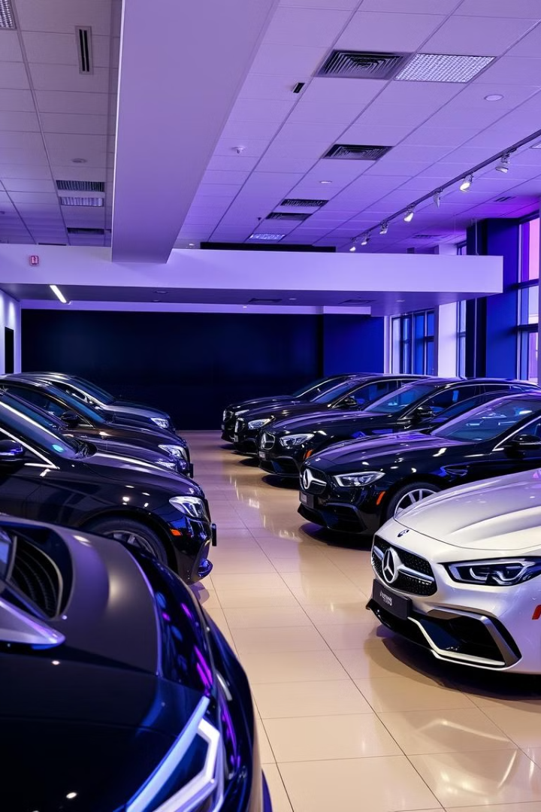
3
Introduction: The Project Goal
This project aimed to create a user-friendly car dealership website, showcasing a range of vehicles and simplifying the customer journey.

Slide 4
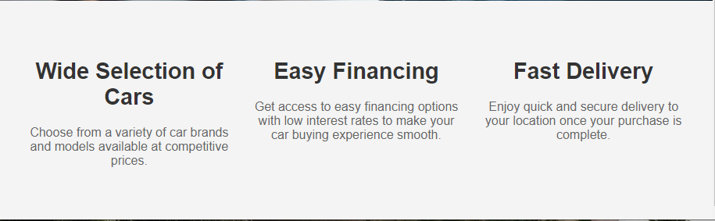
4
Home Page Overview
1
Responsive
2
2. Vehicle Highlights
3
3. Contact Information
The homepage features an eye-catching banner image of a featured car with a clear call-to-action.
A curated selection of popular vehicles is showcased, with concise descriptions and pricing.
The homepage prominently displays contact information, ensuring easy communication.

Slide 5
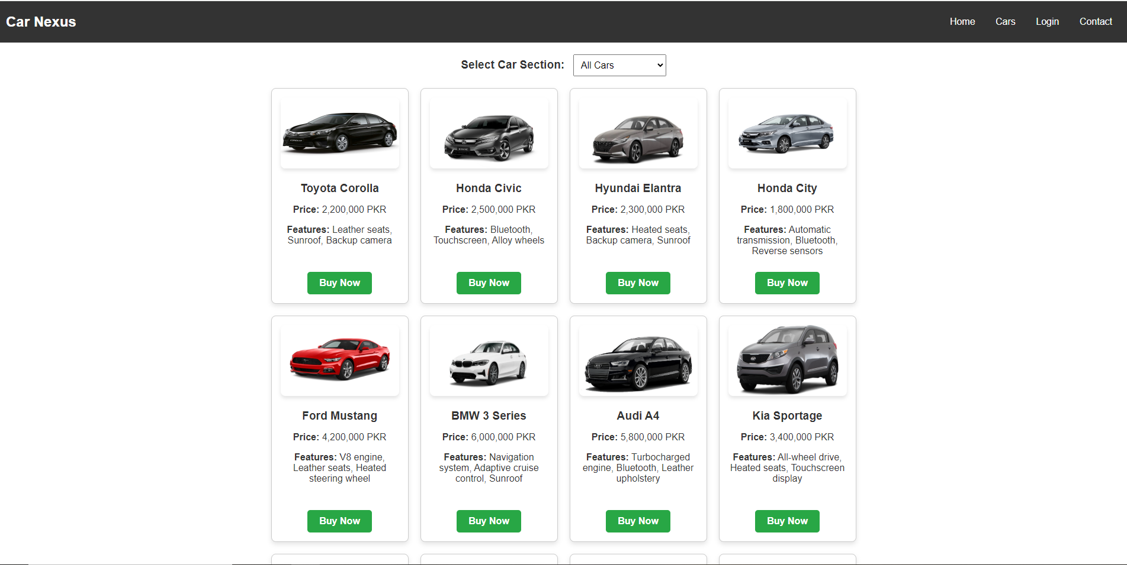
5
Cars Page: Exploring Inventory
Search Filters
Detailed Vehicle Pages
Interactive Features
The cars page provides filtering options to refine the search, including make, model, year, and price range.
Each car listing includes high-resolution images, detailed specifications, and a link to view the vehicle's inventory.
The Car page include a variety of cars with different sections and their features.

Slide 6
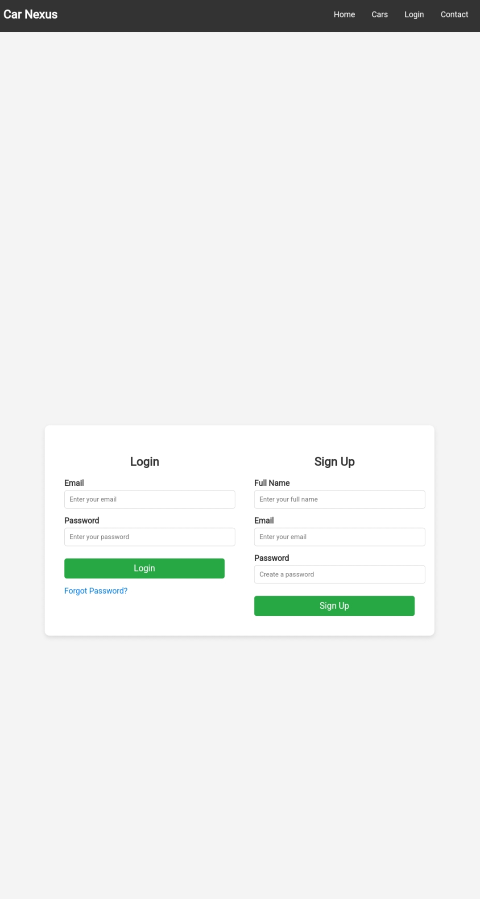



6
Login Page: Secure Access
Secure Authentication
The login page uses industry-standard security measures to protect user information.
Data Encryption
Sensitive user data is encrypted during transmission, safeguarding privacy.
Password Protection
Strong password policies and secure login procedures are implemented.

Slide 7
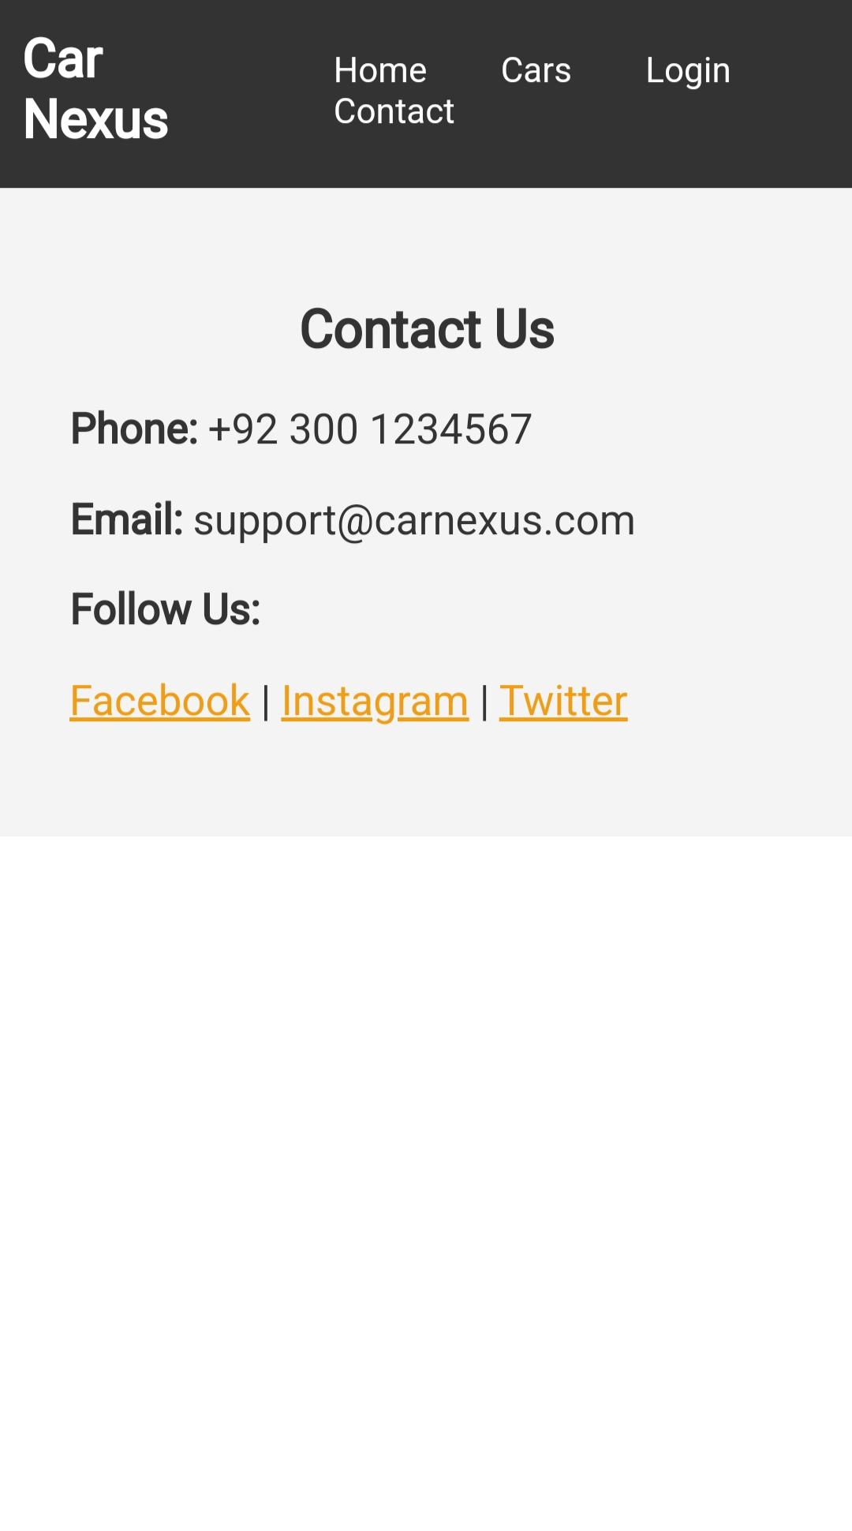
7
Contact Page: Easy Communication
1
Contact Form
A user-friendly contact form allows customers to submit inquiries and feedback directly.
2
Address and Phone
The contact page displays the dealership's physical address, phone number, and email address.
3
Interactive Map
An interactive map with directions assists customers in finding the dealership's location.

Slide 8
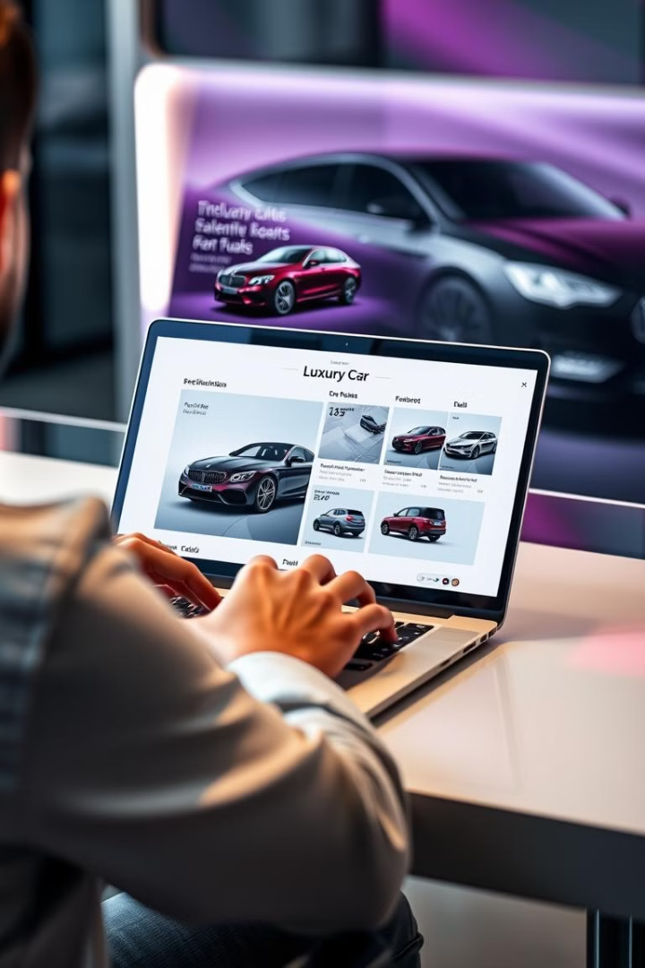



8
Website Design and User Experience
Responsive Design
The website adapts to different screen sizes, ensuring a seamless experience across devices.
Intuitive Navigation
Clear navigation menus and breadcrumbs guide users through the website.
Visually Appealing
A modern design with high-quality images, engaging content, and consistent branding creates a positive user experience.

Slide 9



9
Challenges and Lessons Learned
Time Management
1
Balancing academic commitments with project development presented a challenge.
Technical Skills
2
Developing proficiency in new technologies and frameworks was a learning curve.
User Testing
3
Gathering feedback from potential users helped identify areas for improvement.

Slide 10
10
Next Steps and Future Improvements
Enhance Features
1
Adding features like online financing and appointment scheduling would improve user convenience.
Improve Accessibility
2
Implementing accessibility features would ensure inclusivity for all users.
Expand Content
3
Adding comprehensive blog posts and articles on car maintenance and automotive trends could engage users.

